Slide 1

Learning from poor visual design
Data Visualisation

Slide 2
Overview
Examples of poor design are presented in the form of
  3D QTD Sales
  Table showing poll of countries opinion of the US
  Product Comparisons using a bar chart
  Pie chart showing Market Share
  Poor design by mistake
  Poor design on purpose
  Misleading correlations

Slide 3
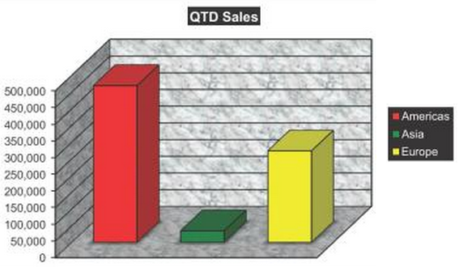
Poor Design – example 1 – QTD Sales
Too often, graphs are not designed properly to clearly show all the information they were intended for.
What does this graph tell you?

Slide 4
Poor Design – What we see
Sales for Americas > Sales for Europe > Sales of Asia
Sales of Asia are poor compared to other regions
Sales for Americas are +400K, Europe +200K, Asia +- 50K
Actual Sales
Americas : $469,384
Europe : $273,854
Asia : $33,847

Slide 5
Poor Design – What do not see?
Sales are international – so what currency is shown?
What is the date (months and year) of the QTD sales?
How do these figures compare to the plan for the quarter?
Compare to this time last year or even last quarter?
Are sales getting better or worse?
What would be a better design?

Slide 6
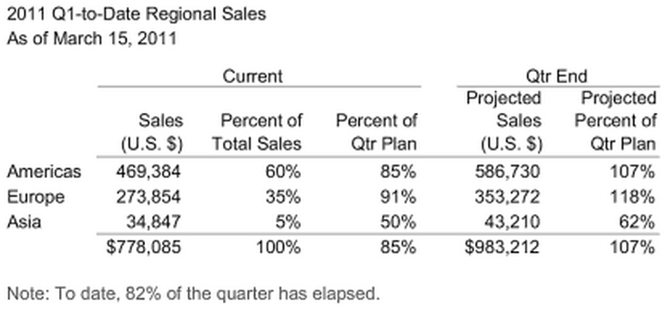
Poor Design – A better design implemented

Slide 7
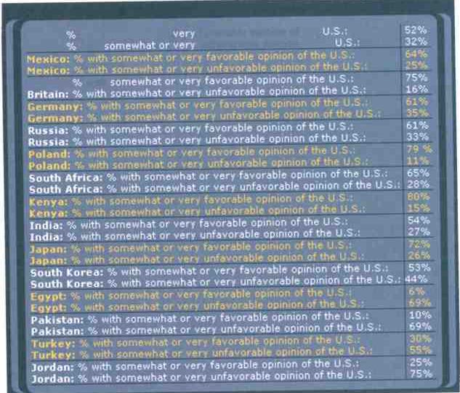
Poor Design – example 2 - Poll of countries opinion of US
The Table across reports information that was collected by Pew Research Centre, as presented by PBS TV program now.
What do we see?
Could we have presented the same information in any other way in order to add clarity?

Slide 8
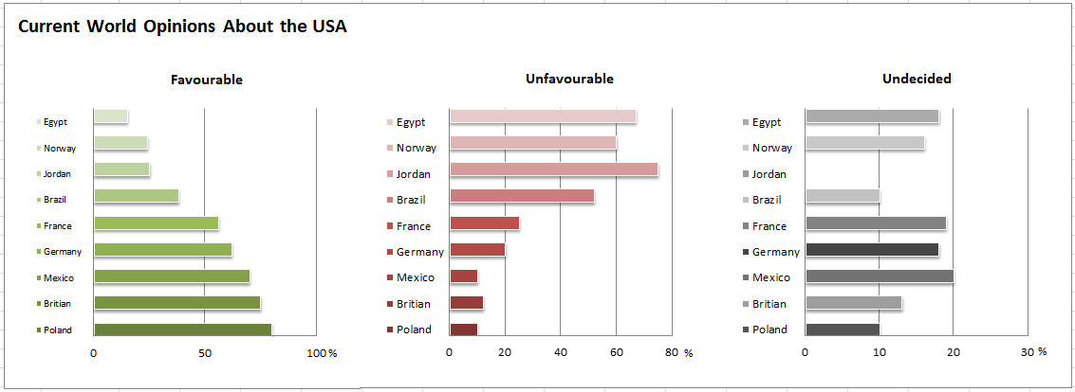
Poor Design – a better design
Story comes alive and other details are seen for the first time.
Do you see anything that you did not see clearly on the last presentation?

Slide 9
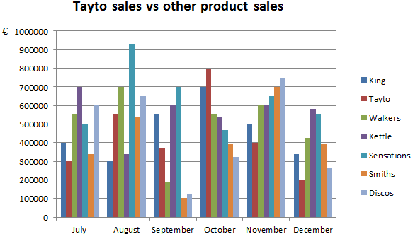
Poor Design – example 3 – Product comparisons
Without the graph’s title would you know the purpose is to compare sales performance of “Tayto” against the rest?
Challenge 1
Graph’s purpose is to compare how the product Tayto does against each product over the last few months. We do not care about actual Euro amounts.
Examine the graph and now make a list of where the design fails to meet this objective
Challenge 2
Take a moment to list the features you would incorporate into a new version of a graph to meet the initial objectives.
It may be useful to reference the previous list you created.

Slide 10
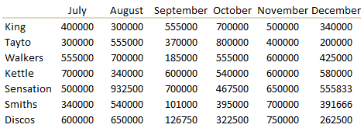
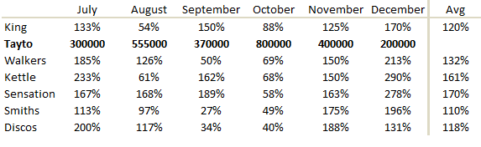
Poor Design – example 3
Lets look at the raw data

Slide 11
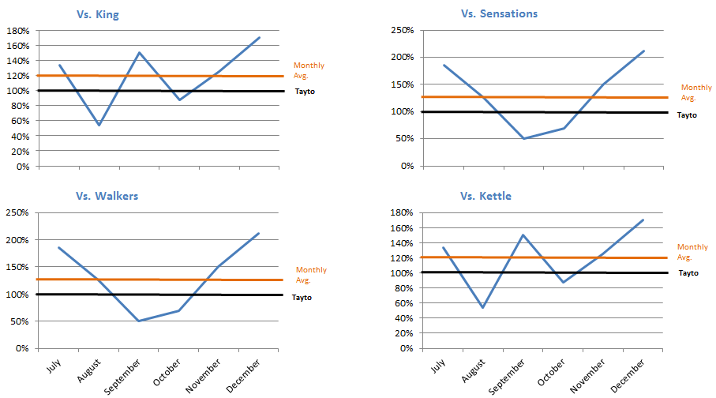
Poor Design – example 3 – Divide and Conquer

Slide 12
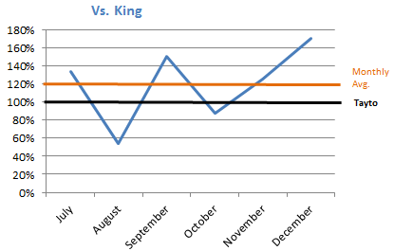
Poor Design – example 3 – Lets just look at one

Slide 13
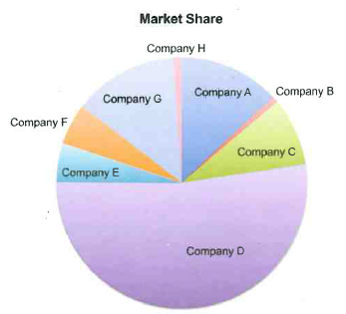
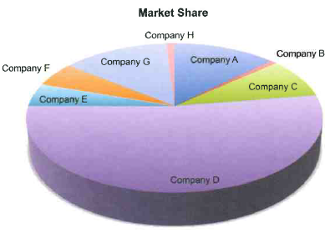
Poor Design – example 4 – Market Share
Can you get all the information you need from this Visualisation?
Our company is company G
Does the 3D effect help here?
What better way could you design this?

Slide 14
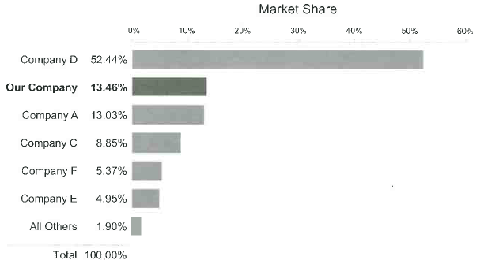
Poor Design – example 4 – Market Share improved design
Look at how this graph makes it easier for you to get the information.
What is easy to see?

Slide 15
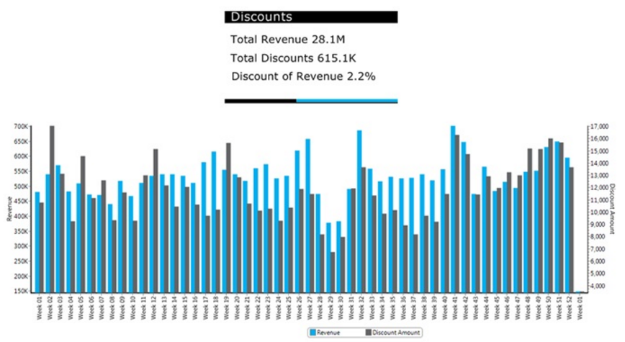
Poor Design By Mistake
Manager asked to increase the yearly profit margin by 2 percent.

Slide 16
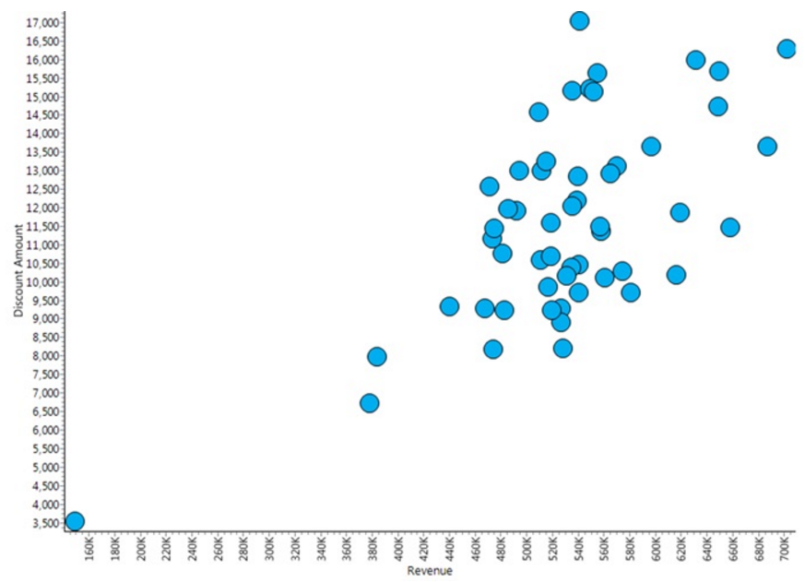
Poor Design By Mistake
Make sure you pick the right chart!

Slide 17
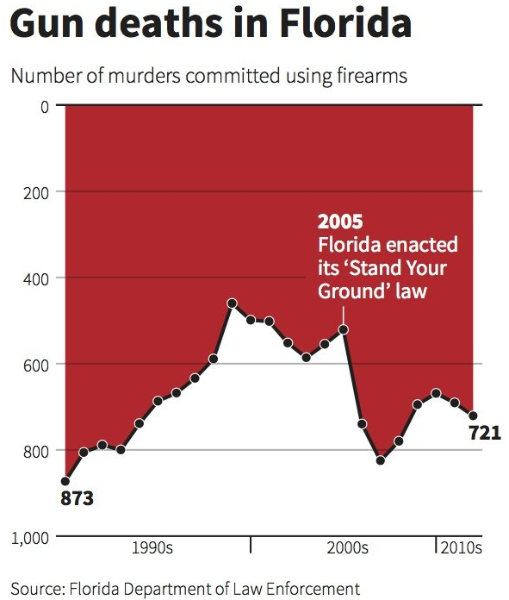
Poor Design on Purpose
The data is correct but lets put a positive spin on what the user will see.

Slide 18
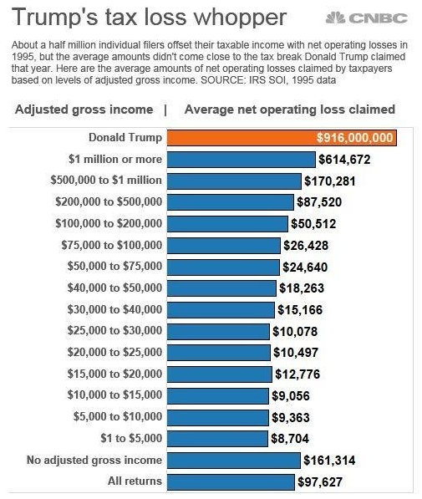
Poor Design on Purpose
Diagram shows the average losses by taxpayers in various income brackets.
Trump is top of the list but doesn’t appear to be a huge difference

Slide 19
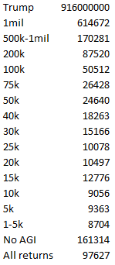
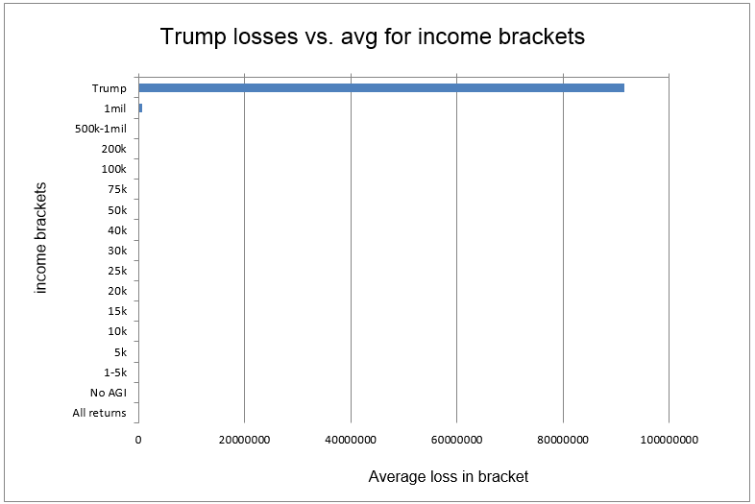
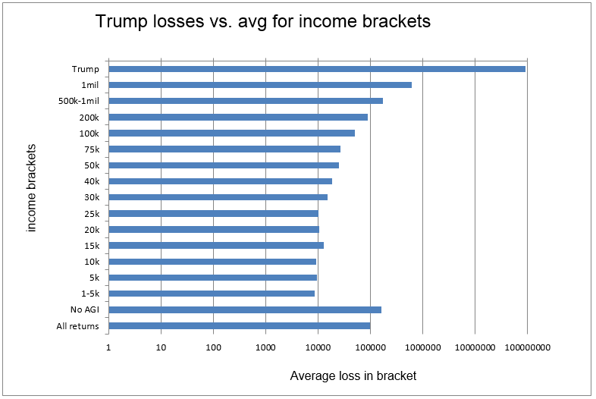
Poor Design on Purpose
Lets look at the data

Slide 20
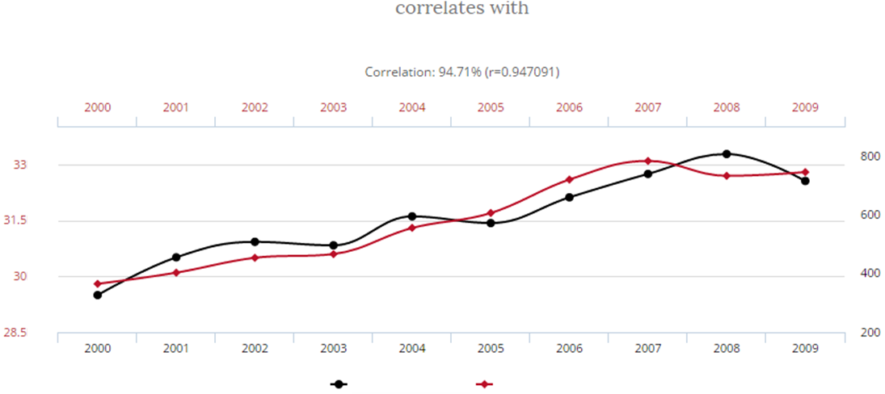
Misleading correlations - “Correlation is not causation”
Sales
Revenue
Sales
Revenue
Sales
Revenue

Slide 21
Misleading correlations - “Correlation is not causation”
Number of people who died by becoming tangled in their bed sheets
Total revenue generated by skiing facilities
Deaths
Revenue
Deaths
Revenue

Slide 22
Tables and graphs of quantitative business information
Can be used for four purposes;
    Analyzing
    Communicating
    Monitoring
    Planning

